Slide 1
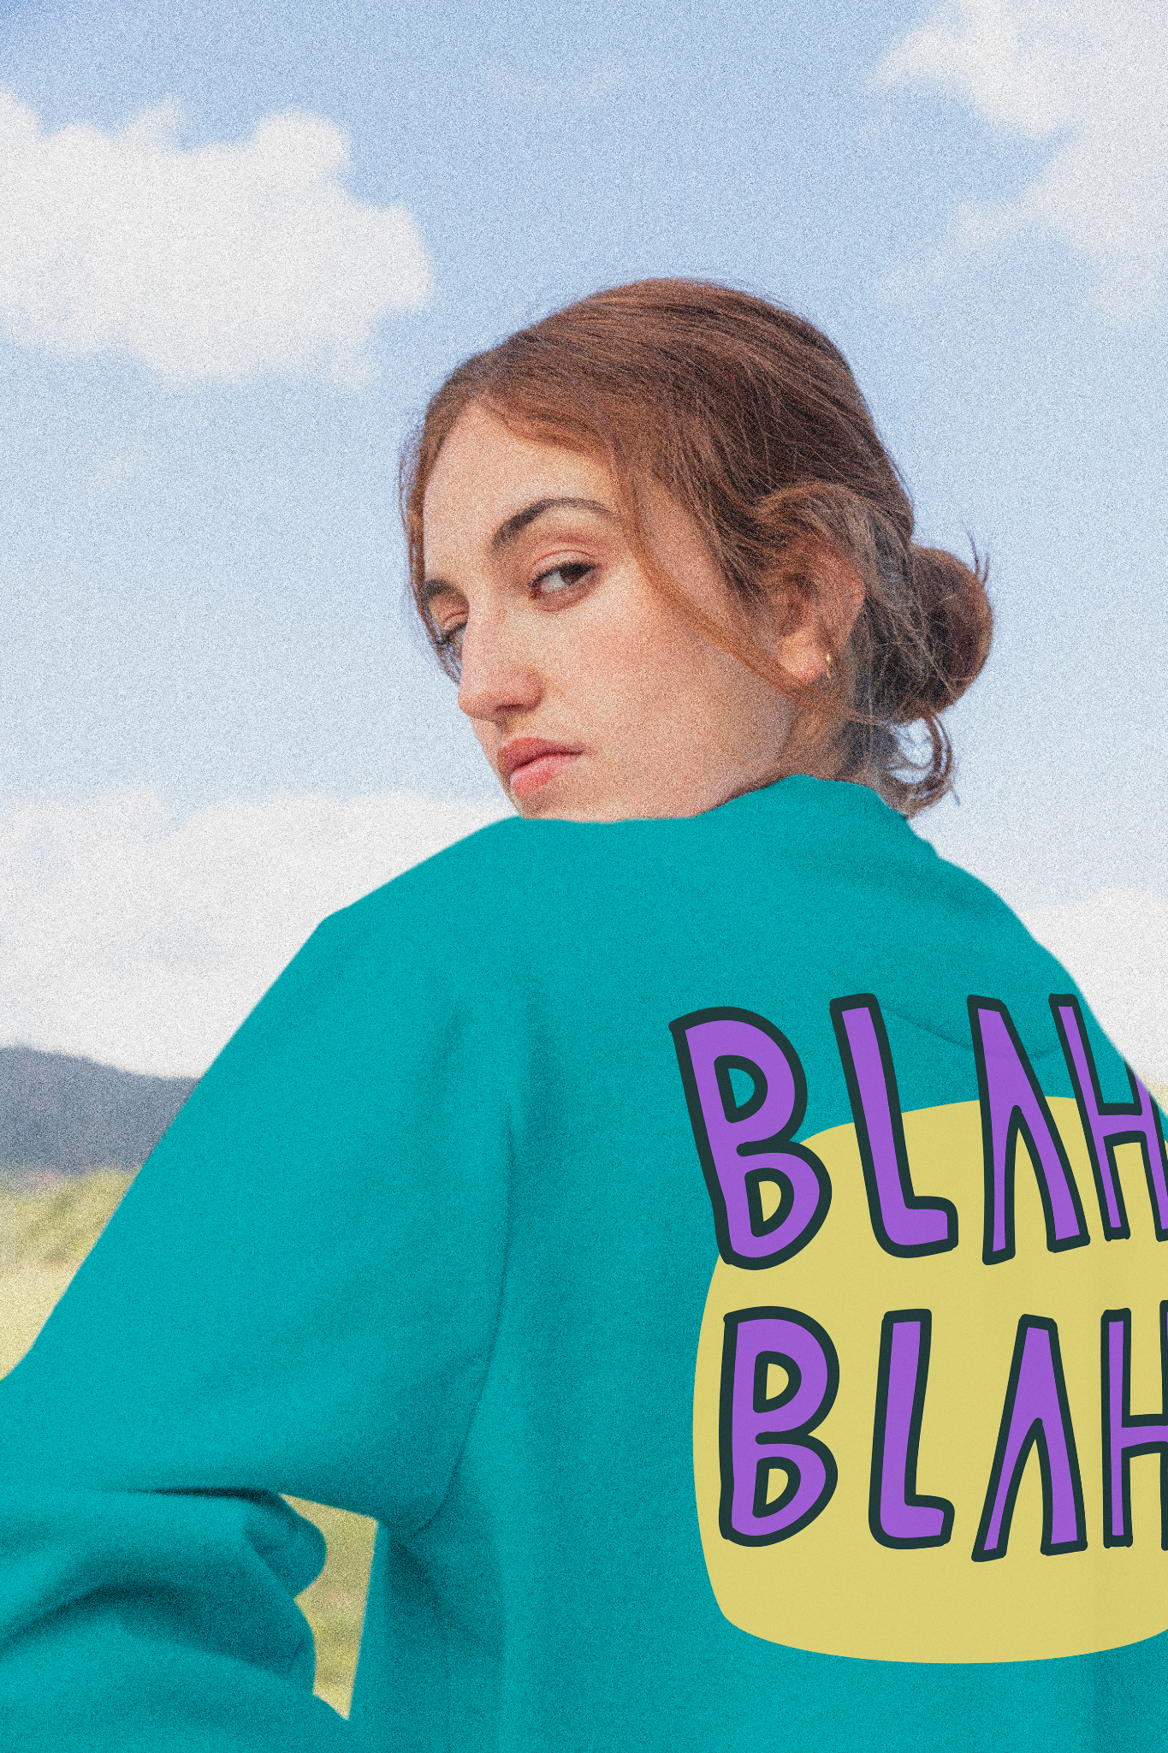
Report speECH-con-trolled RoBOT
Machine Learning and Bluetooth on an Embedded System

Slide 2
table of contents
01
Project Description
02
Machine learning
BLUEtooth
Conclusions
03
04
Pipeline and Technologies
How technologies are implemented
Quick introduction of bluetooth
Final lines

Slide 3
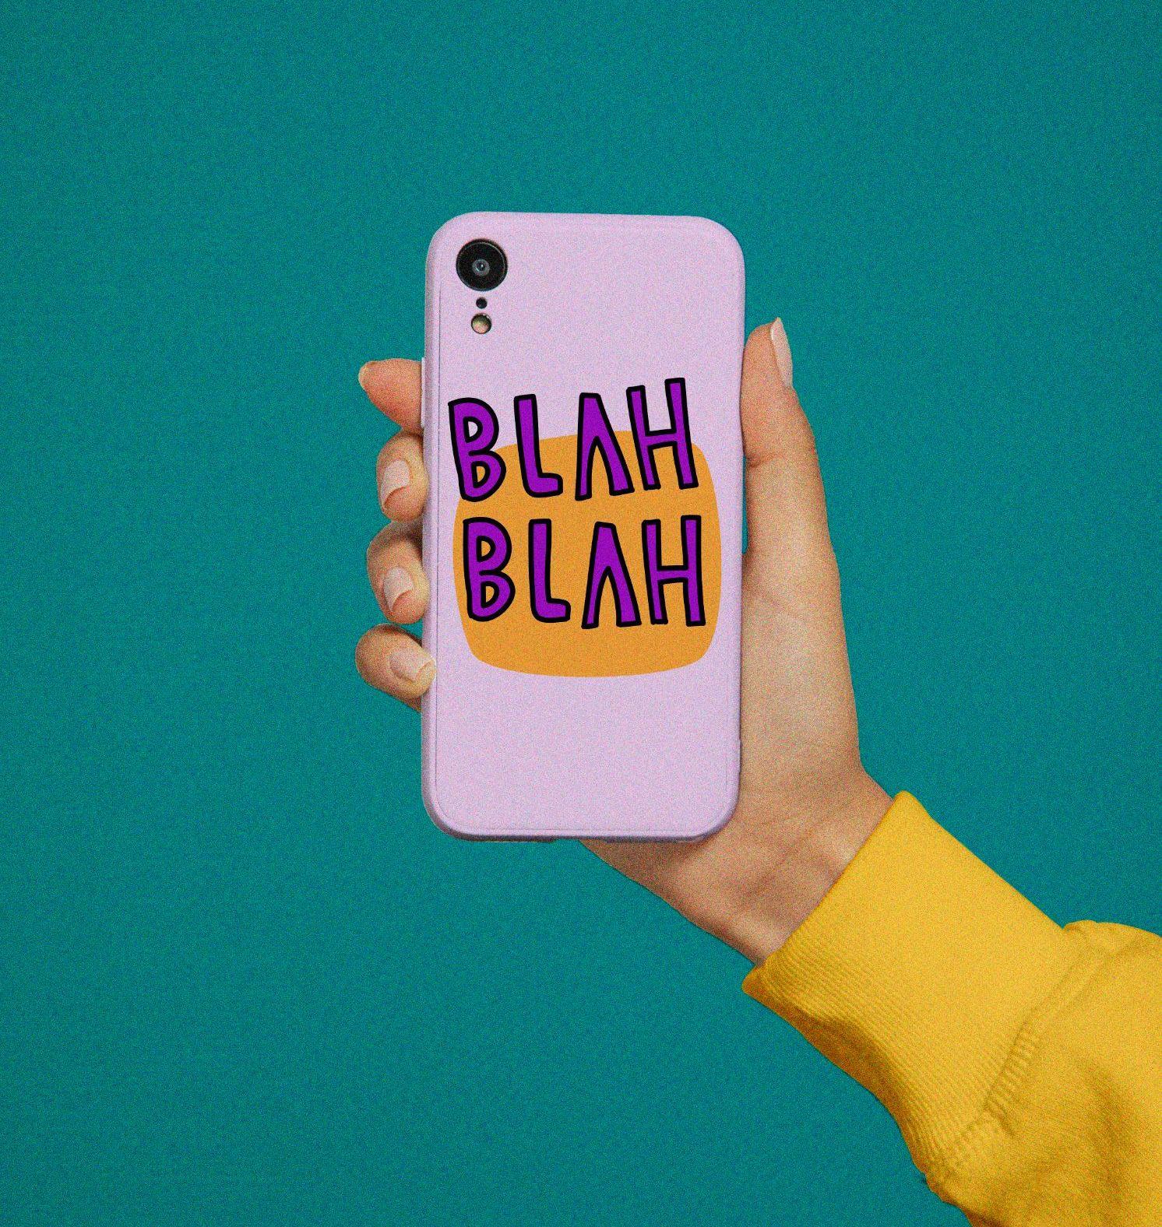
AcknowLedgment
This project cannot be completed without the helps of my awesome brothers. I want to show my appreciation to Mr. Than, Quyet, Mr. Phuc, Hai, Tu, Minh, Truong;.

Slide 4
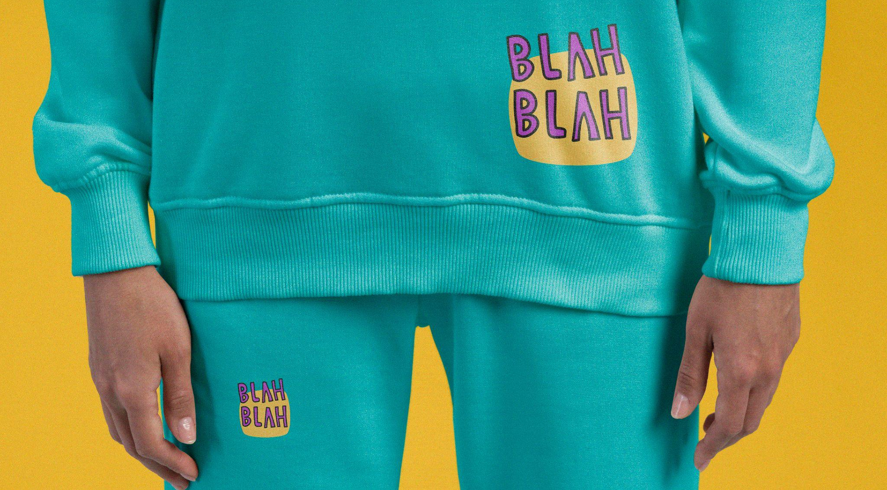
01
Project Descrip-tion
Pipeline and Technologies

Slide 5
project description
1. Recognize speech commands using thunderboard sense 2
2. Transmit commands through
Bluetooth
3. The robot, controlled by bgm220, receives commands and do accordingly
4. Commands: Turn left, turn right, stop and go
Notes:
Machine learning technology gives the machine the ability to make prediction.

Slide 6
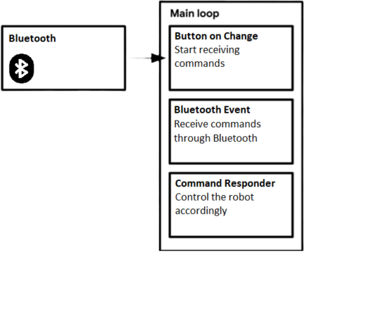
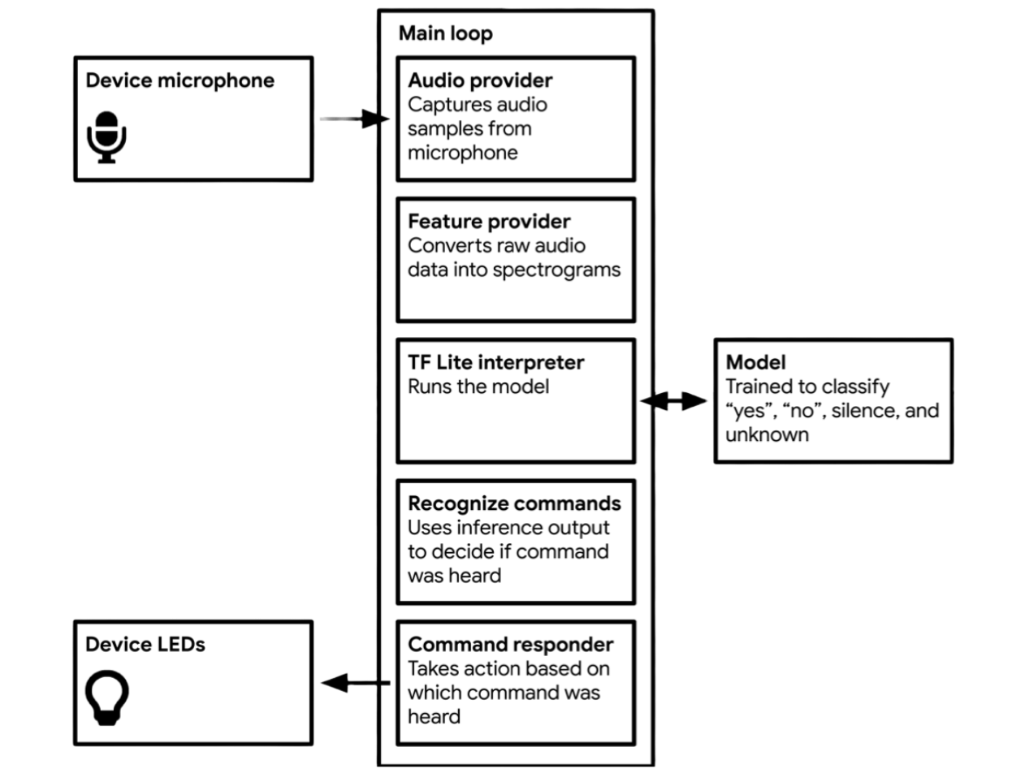

PIPELine
BGM220
thunderboard
Notes:
Machine learning technology gives the machine the ability to make prediction.

Slide 7
02
MAchine Learning
Quick introduction of Neural Networks, CNNs,…

Slide 8
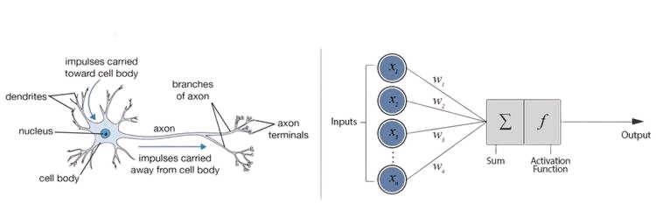
Machine lEarning
^
X
y
F(x) = WX+b = Y-hat
Notes:
Machine learning technology gives the machine the ability to make prediction.

Slide 9
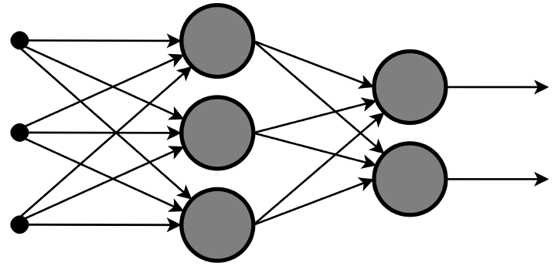
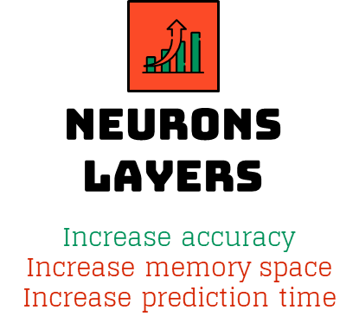
neural network
Input
Layer 1
Layer 2

Slide 10
model Architecture
Number of layers | 2 | 2 | 2 | 3 | 3
Neurons in layer 1 | 8 | 8 | 8 | 8 | 16
Neurons in layer 2 | 8 | 16 | 32 | 8 | 8
Neurons in layer 3 | None | None | None | 8 | 8
Output per second | 6 | 4 | 2 | 2 | 1
Accuracy | 79% | 80% | None | None | None
Memory | 55kB | 91kB | 162kB | 87kB | 123kB
Conclusion | Good | Good | Too slow | Too slow | Too slow

Slide 11
03
BLUE TOOTH
Quick introduction of Bluetooth

Slide 12
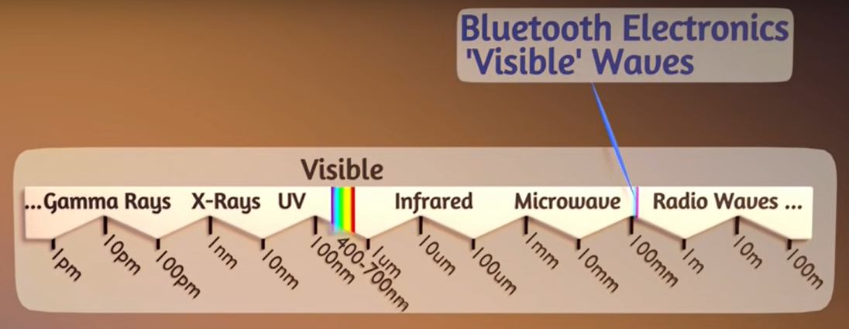
Electromagnetic Waves

Slide 13
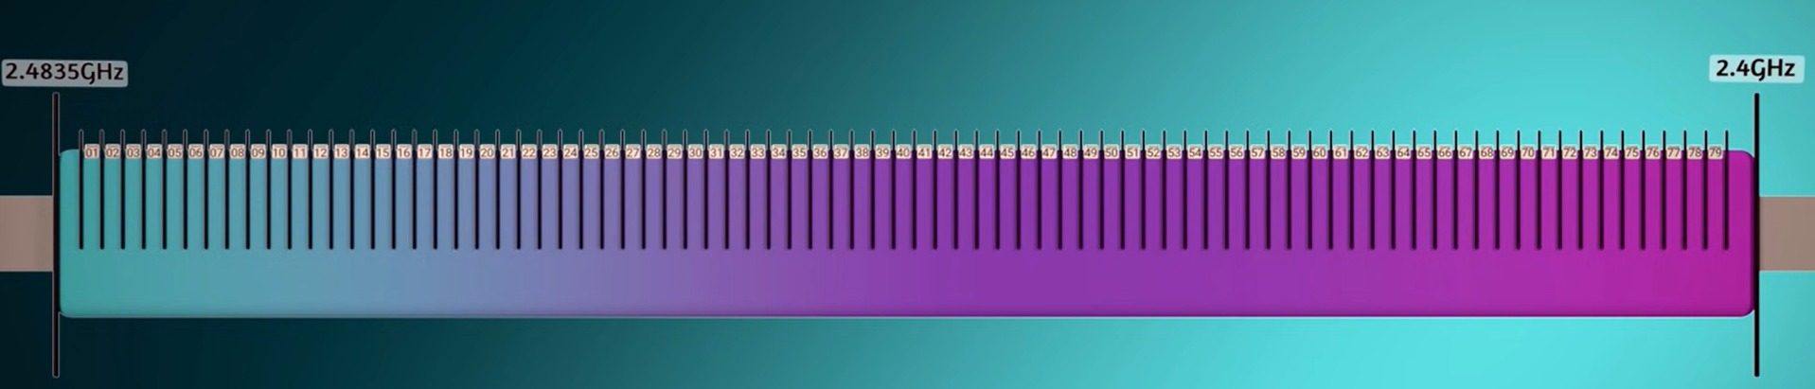
bluetooth Channels
79 channels To accommodate multiple bluetooth users.
Each channel has specific frequencies for 0’s and 1’s.

Slide 14
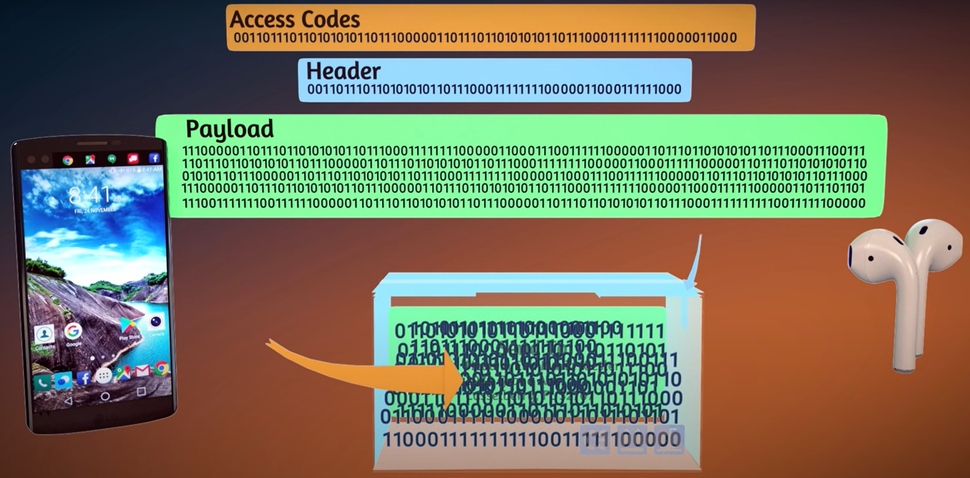
bluetooth Packets
Notes:
Access code: first 72 bits for devices synchronization
Header: next 54 bits detail of the information being sent: size …
Payload: contents

Slide 15
04
Conclu- sion

Slide 16
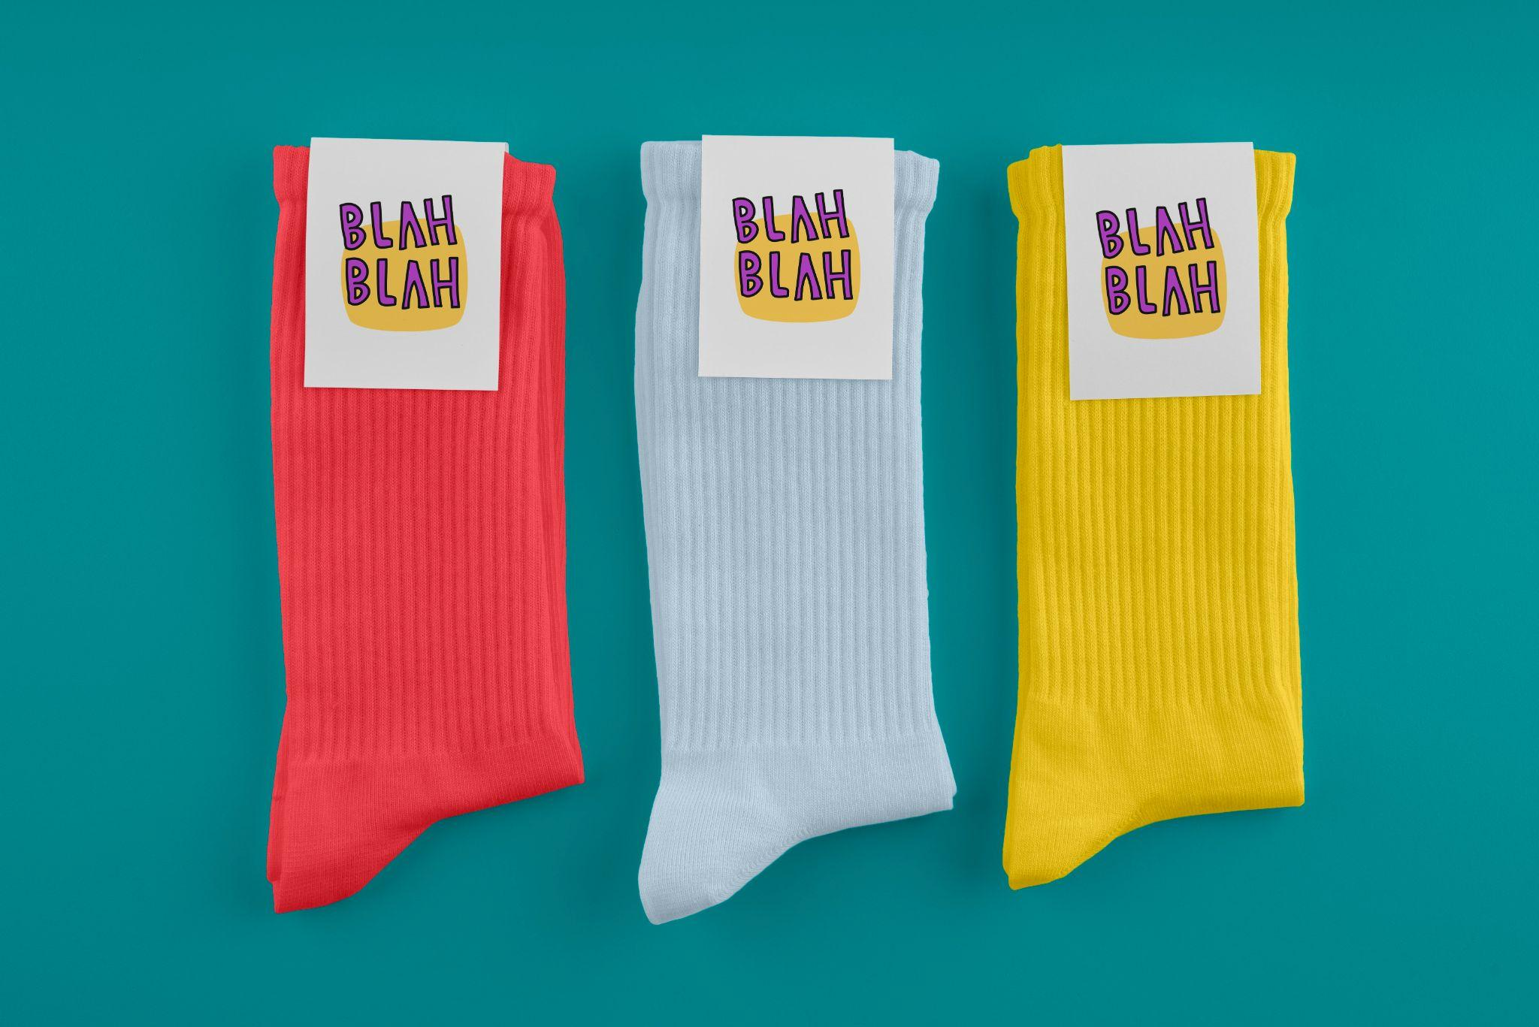
THANKS!

